Slide 1
Quest: Data Management at the ERDC
Scott Christensen, PhD US Army Engineer Research and Development Center
Co-Authors:
Dharhas Pothina, PhD, PE
Aaron Valoroso
Lakenya Walker
Kevin Winters

Slide 2



The ERDC Data Challenges
2nd Death
(i.e. non-discoverable data)
Data Discovery

Slide 3
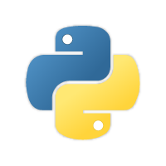

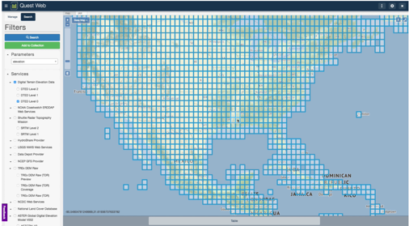




Software Tools Overview
Quest – an extensible Python API with the ability to discover, retrieve, process, and publish data.
Quest App – a web interface for Quest built using Tethys Platform.
Data Depot – an internal instance of HydroShare, a repository used for sharing and publishing data.
Quest App

Slide 4



Data Access Approaches
Etc.
Unified API

Slide 5

Extensible Data Access API Architecture
Providers
Filters
IO

Slide 6
What’s Next?
Ulmo
Move Provider plugins to 3rd Party Library: Ulmo
Replace I/O plugins with Anaconda Intake
Add more Provider and Filter Plugins
Filters
Intake

Slide 7


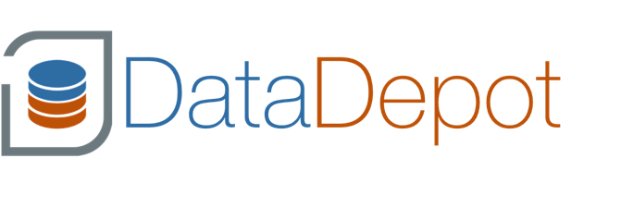
Thank You
Scott Christensen Scott.D.Christensen@usace.army.mil
US Army Engineer Research and Development Center
Information Technology Laboratory
Quest App
Code Repositories:
https://github.com/erdc/quest
https://github.com/erdc/tethysapp-quest

